Slide 1
Optimizing Deep Networks Through Predicting NBA Game Outcomes
Hermes Suen
3/24/2020

Slide 2

Motivation : NBA
Real Problem
See if optimization leads to tangible changes
Personal interest

Slide 3
The Data
Pulled data from Kaggle
Nathan Lauga
All games from 2004-February 2020
Easier than scraping
.CSV files for simple processing
Features:
Game's date
ID of the game
Status: Final means that the is completed
ID of the home team
ID of the visitor team
Season when the game occurred
D of the home team (duplicate of HOME_TEAM_ID)
Number of points scored by home team
Field Goal Percentage home team
Free Throw Percentage of the home team
Three Point Percentage of the home team
Assists of the home team
Rebounds of the home team
ID of the away team (duplicate of VISITOR_TEAM_ID)
Number of points scored by away team
Field Goal Percentage away team
Free Throw Percentage of the away team
Three Point Percentage of the away team
Assist of the away team
Rebounds of the away team
If home team won the game

Slide 4
The Problem
Does Home Team win the game?
Unlike other “traditional” machine learning problems; highly variable with many human components to NBA games: may not be a ‘learnable’ function
Accuracy measurements:
50% is worst we can possibly do (i.e. flip predictions)
Sports Experts predict ~70% of games correctly
Academic papers: 65-70% accuracy with machine learning/deep learning

Slide 5

Feature Engineering
Can’t let the network “see the future”
Need to predict off past games
Use idea of “exponential moving average” (a technique used several times in this book):
Take exponential average of home/away team statistics for previous 10 games

Slide 6
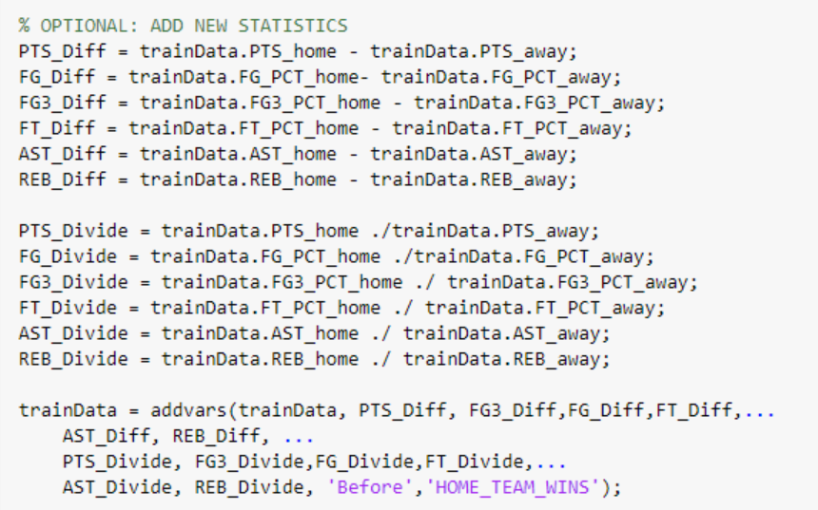
Feature Engineering(2)
Add new features after calculating exponential average
Want Differential between home and visitor team
Thus calculate Ratio and Difference between all statistics (make sure no NaNs, throw those out)

Slide 7
Training/Validation Test
“Typically one uses 80% of TRAINING data for training and 20% for validation” (p.118)
Also use 80% of total data for training and 20% for testing
If 10 observations prior to the game were unavailable to calculate, then discarded that point
Thus:
Training Data total: 18556
Training: 14844
Validation: 3712
Testing:4639
However, no validation set was used since overfitting the data never became a problem: training accuracy never higher than 70% (did not need to implement “early stopping” for regularization)

Slide 8
Designing the Network
MATLAB deep learning only supports image, sequence, and text data right now, so need to use the following workaround:
https://www.mathworks.com/matlabcentral/answers/395817-can-i-use-trainnetwork-to-train-deep-neural-networks-with-non-image-or-non-sequence-data-for-regre

Slide 9
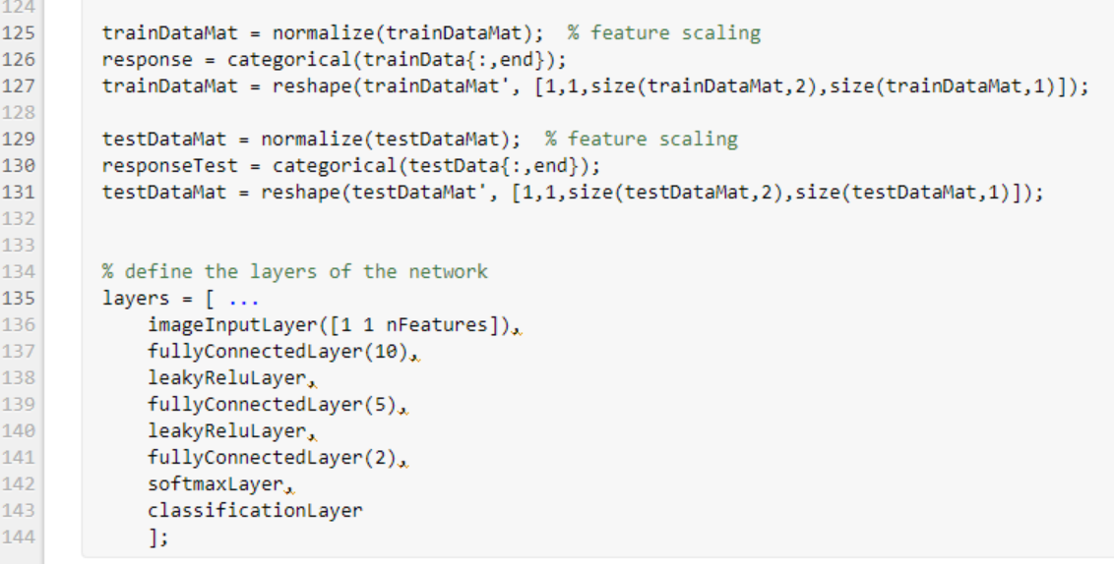

Slide 10
Design Considerations for Network
Relatively small number of inputs (24 features) so simply 10-5-2 structure seemed appropriate
Use a fullyConnectedLayer with num output classes, then softmax to convert to probabilities, and then classification layer to determine the binary cross-entropy loss which is standard for classification (same as log-likelihood more on this later)
Use “leakyRelu” because ReLu has been recommended standard, and leaky Relu prevents gradients from going to zero
Normalized the data for better results (some features are on a different scale)

Slide 11
Solvers
MATLAB offers three solvers:
SGDM (stochastic gradient descent with momentum)
rmsprop
Adam
Start with sgdm to demonstrate a few optimization concepts
Nearly ALL optimization techniques//options are Name-Value pairs in “trainingOptions”

Slide 12
Trial 1
10-5-2 Structure
LeakyReLu hidden units SGDM
LearnRate: 0.01
Momentum: 0.9
Mini-Batch: 128
L2 Reguralization: 0.0001
(default values). Accuracy: ~ 61.8%

Slide 13
Trial 2
The graph looks like it is following a pattern, and shuffle every epoch:
Accuracy jumps to ~ 62.14%
Conclusion: shuffling add “noise” leads to better generalization
Helps the solver not get stuck in a cycle

Slide 14
Mini-Batch Adjustments
Mini-Batch: mathematical proof that your estimate of the gradient does not go up linearly with more samples (more efficient to use smaller samples)
Machine Learning already not like general optimization in that the surrogate function to optimize is a sum over training examples
Lends itself to mini-batches
“minibatch stochastic gradient descent follows the gradient of the true generalization error” (p.273)
If randomly sampled and only go through data set once
Small batches offer regularization because of added noise. Need to use a smaller learning rate with this though to counteract the extra variance

Slide 15
Trial 3
Mini-batch: down from 128 -> 64
Scales down in powers of 2 because GPUs work better with these sorts of array sizes
Drop learn rate down by magnitude of 10 to counteract : 0.01 -> 0.001
Changes to learn rate should happen in magnitudes
Accuracy: 59.92%

Slide 16
Trial 4
Drop Learn Rate by another factor of 10 to see if improvement goes up:
Accuracy: 60.25%

Slide 17
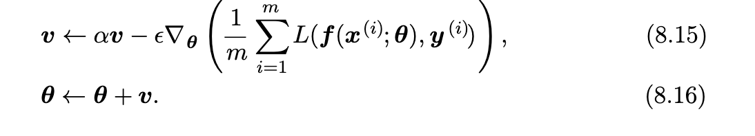
Momentum
Used to help fight:
Noisy gradients
Accelerate learning
The idea is to keep a exponential moving average of past gradients so when there is added noise to gradient values, the “search” does not go off in a wild direction

Slide 18
Momentum
The second term is SGD
The first term is computing an exponentially decaying average
Must be less than 1 (so that contribution of previous gradients becomes less as the number of iterations increase; repeatedly multiplying by a value less than 1)
Default in MATLAB: 0.9

Slide 19
Physical Analogy
Think of a hockey puck with momentum (velocity + mass)
This is our search point
The negative gradient of the cost function is a force pushing on it
SGD, we would take a step in direction of gradient
Momentum, the force merely alters the general velocity, or direction we are heading

Slide 20
Trial 5
Drop Momentum down to 0.5
Hopes that we add more variance to the search directions and find a different local minimum
Accuracy: 61.36%

Slide 21
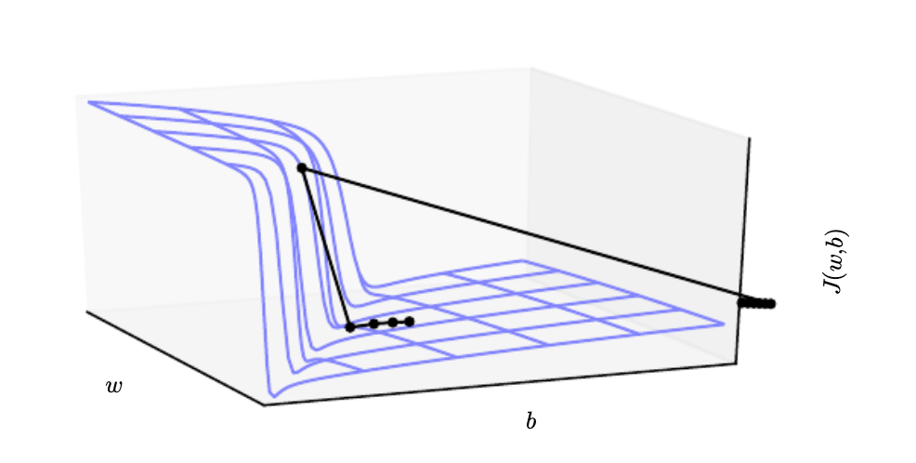
Cliffs and Exploding Gradients: Adding Gradient Clipping
Deep nets may have a cost function that resembles the following:
The direction to lower the cost function is one in which the gradient is very large (go down the cliff). The parameters will make a big jump and leap too far, landing in a sub-optimal point (leap off the cliff)

Slide 22
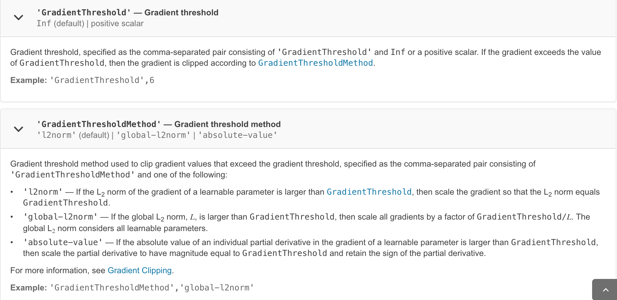
Trial 6
MATLAB options:
Set Threshold to 15
Accuracy: 62.70%
Other parameter determines what gradient to use if threshold is exceeded

Slide 23
Adaptive Learning Rate: AdaGrad & RMSProp
Learning rate highly affects performance of models
Cost function is very variable in different directions of the parameter space
“Adapt learning rate of all model parameters by scaling them inversely proportional to the square root of the sum of all historical squared values of the gradient” (p.299- AdaGrad)
This has the effect of boosting the learning rate for directions in which the gradient has been historically gentle, so we make more progress
In more steep directions (high gradients), we reduce learning rate (sort of like gradient clipping) over time. This follows the general practice of also reducing learning rate as training continues
RMSProp: use an exponential moving average instead

Slide 24
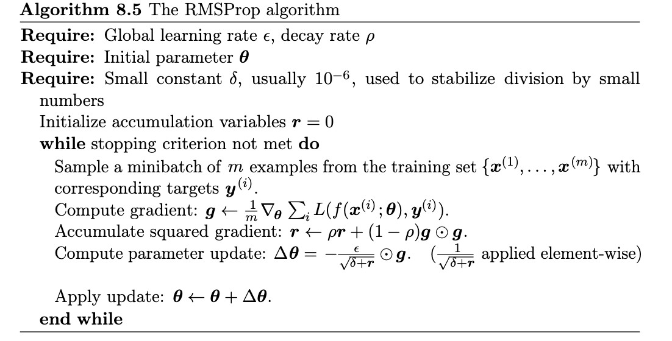
RMSProp

Slide 25
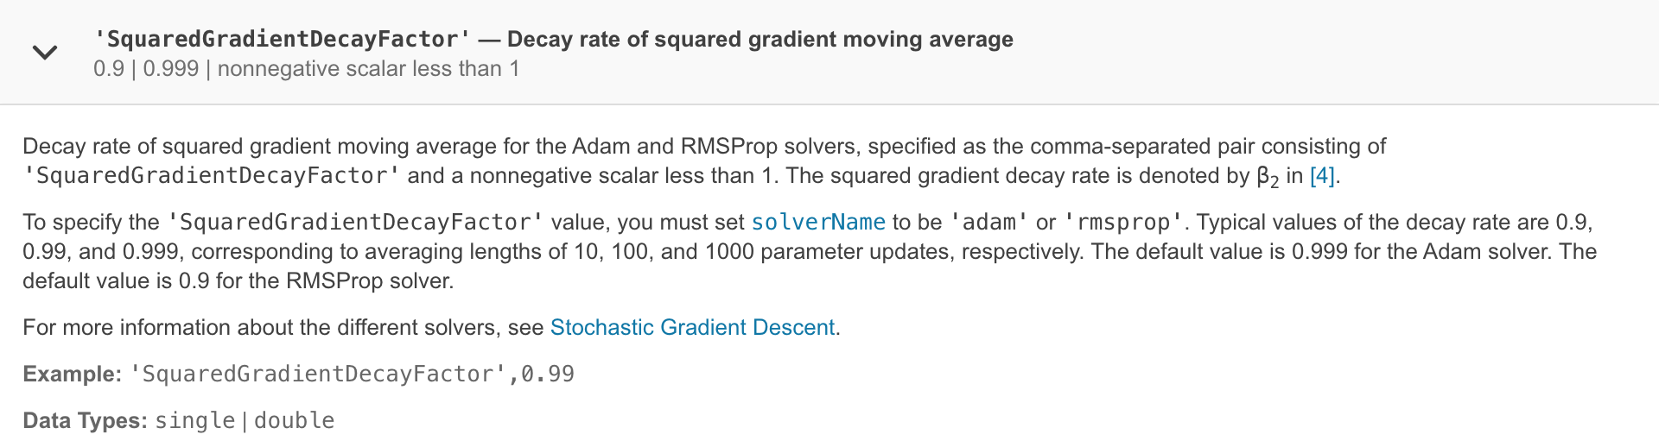
How to Use RMSProp with MATLAB
Momentum no longer available

Slide 26
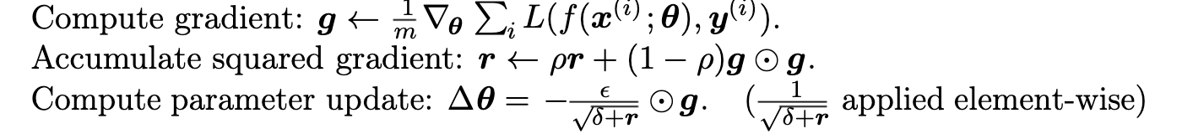
How to Use RMSProp with MATLAB
The “squared gradient decay factor” is the “p” value here:
When we perform the “g * g” we compute a n x n matrix (n being number of features), where the diagonals represent the squared gradients
The “p” value, being less than 1, then creates an exponential moving average by consistently decaying previous gradients. (1-p) ensures that the addition is “1” and we end up with a proper average
The epsilon parameter is a super small number to prevent divide by zero (available as a another name-value pair)

Slide 27
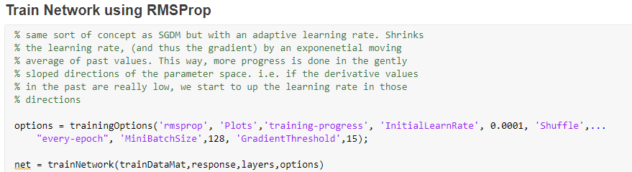
Trial 7
Swap solver
Kept default value, (can play around with it later)
Accuracy: 59-60%

Slide 28
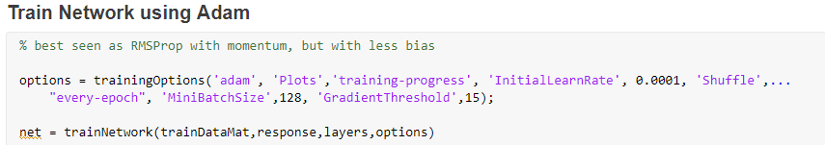
Trial 8 : Adam
Adapting learning rate
Combination of RMSProp and momentum (with differences)
Accuracy still 59-60%

Slide 29
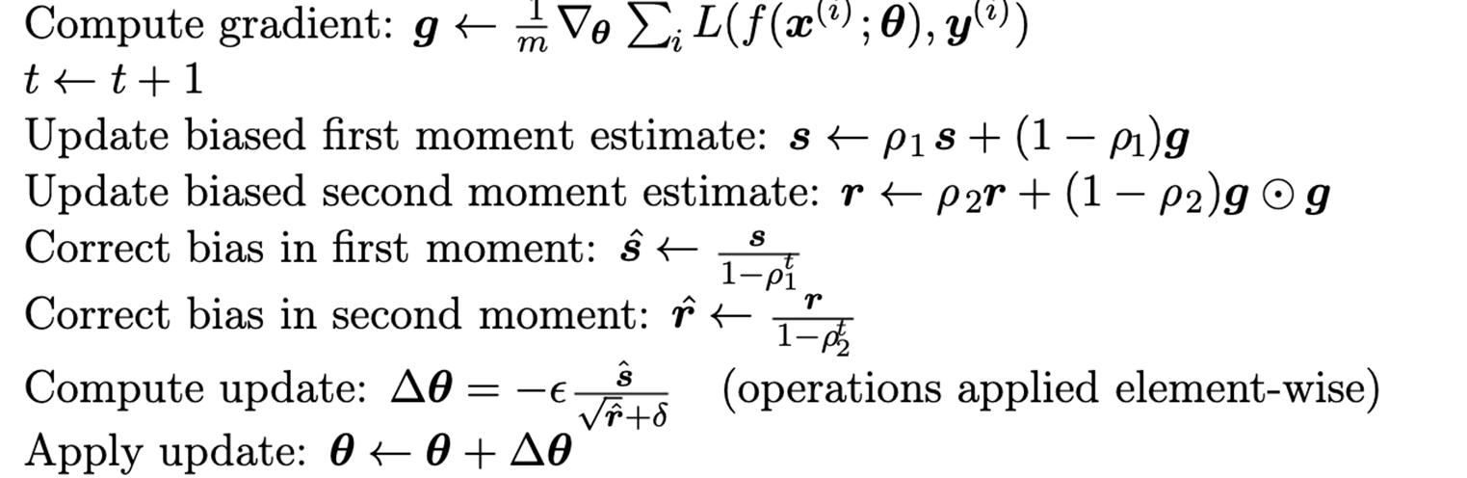
Adam Details
Adds new name-value pair “gradient decay factor”
The Squared gradient decay factor is the second “p”, and it is doing what RMSProp was doing
The “gradient decay factor” is the first p, and its accumulating the normal gradients. Acts as the momentum term

Slide 30

Confusion
S acts as the momentum
R acts as the adaptive learning rate
Re-scaling?

Slide 31
Parameter Initialization
Initial parameters greatly affect the solution; much deep learning research here
Complicated by the fact that some points are better for optimization but NOT generalization
At minimum need “symmetry-breaking” (if same start value, back prop will have it so two neurons will compute the same function)
Can perform a calculation that ensures the initial weight matrix has all units that compute a unique function (expensive)
Usually just draw from Gaussian or uniform, randomized process good enough to perform symmetry-breaking

Slide 32
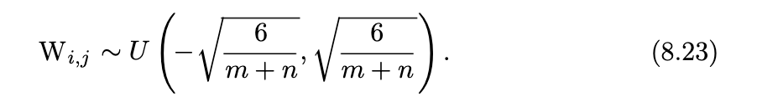
Normalized Initialization
The scale of distribution matters, large scales allow for information to prorogate through the network, since larger values result in larger outputs so certain signals do not get lost
TOO large of scale will result in exploding values and may cause activation function to saturate (zero gradient)
A good heuristic: Glorot and Bengio normalized initialization:

Slide 33
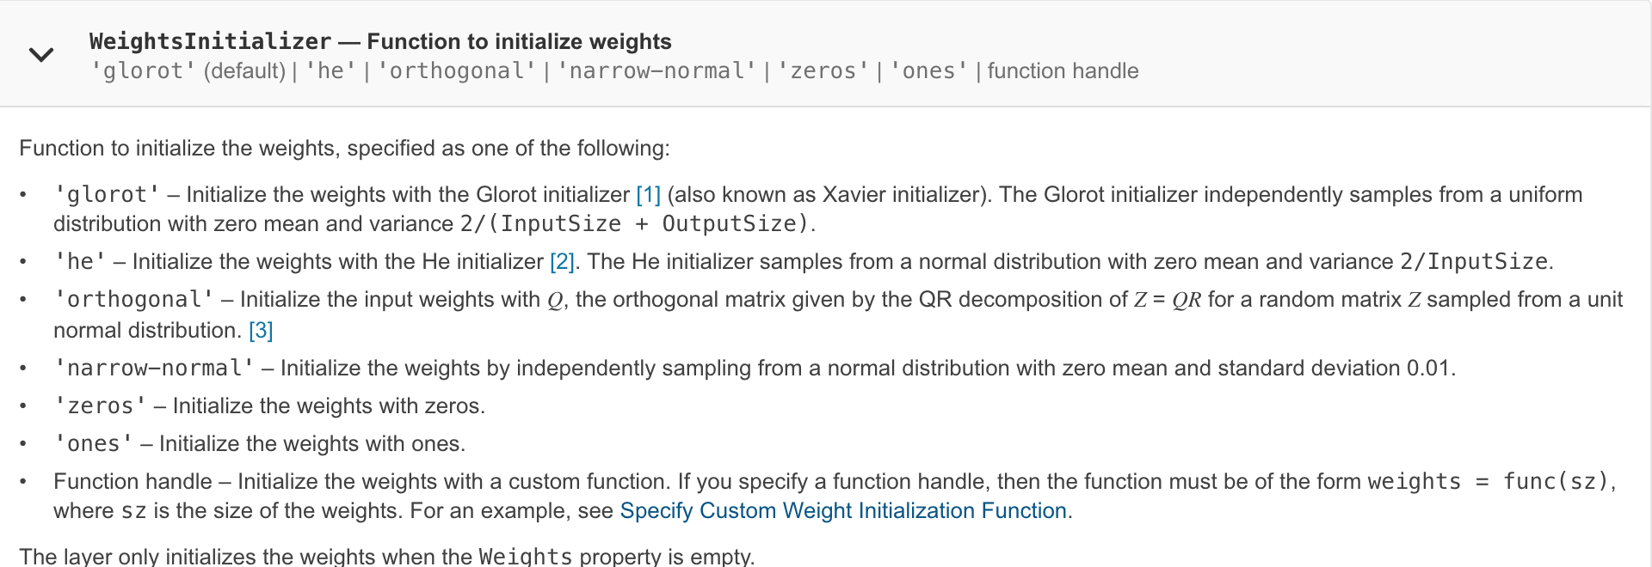
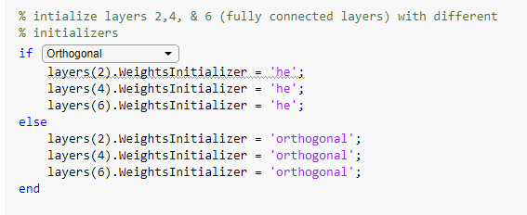
Initialization & MATLAB

Slide 34
Batch-Normalization
A batch normalization layer normalizes each input channel across a mini-batch. To speed up training of convolutional neural networks and reduce the sensitivity to network initialization, use batch normalization layers between convolutional layers and nonlinearities, such as ReLU layers.
Solves the “higher-order” effects problem:
A single update to a simple three neuron network with no activation function will look like the above. For deeper networks, the higher-order effects become even more astronomical. A single update causes many unforeseen changes

Slide 35
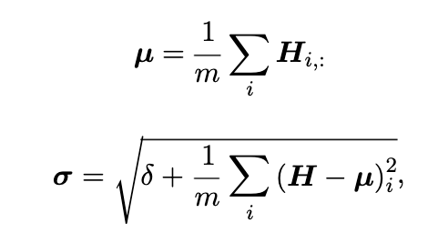

Batch-Normalization
Because of all these effects, it is hard to tune the learning rate since there are big changes between each layer
Batch Normalization performs the following to make the mean and standard deviation of the new distribution to be 0 and 1 (H are the activations for a mini-batch of observations). “u” is the mean, sigma is the standard deviation

Slide 36
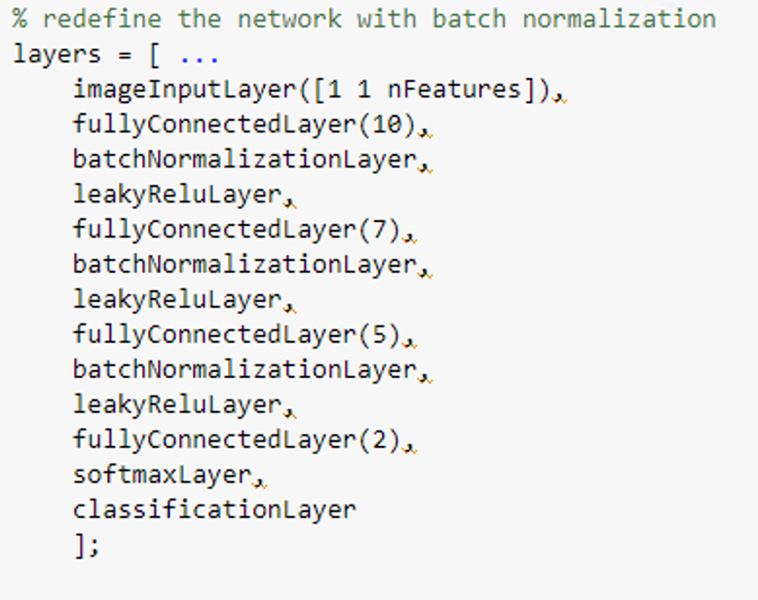
Effects of Batch- Normalization
Gradient will never increase the mean or standard deviation since they stay constant, eliminate all the higher-order effects
If no non-linear activation functions, than re-standardizing makes each layer useless (draw from a gaussian, then create the same gaussian)
The activation functions means that we keep the mean and variance of each unit, but allow the relationships between the layers to change

Slide 37
Summary of NBA Predictor Net
All attempts at better optimization stayed between 59-62% accuracy
Network neither deep not complicated enough for significant improvements
The problem is too simple, reaches 60% accuracy fairly quickly in training (4-5 epochs)
Limited data which makes the function fairly easy to learn

Slide 38
Other relevant concepts

Slide 39
Optimization vs Learning
Learning act indirectly
Approximate the performance measure through a custom Loss function “J” that is a surrogate for the actual performance
We do not know the TRUE distribution that is generating the data; therefore you use what we see empirically to estimate what that distribution is.

Slide 40
Basic Challenges
Functions we are trying to approximate are non-convex
Many local minima
Not sure if it is a global minima so need to try different initial params
Empirically has not actually been a problem
Weight space- symmetry
Can switch the layers of the network up to compute the same local minimum
Who cares?

Slide 41
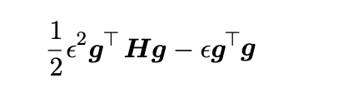
Other Challenges
Hessian matrix is ill-conditioned
Hessian represents the second derivatives; if it is ill-conditioned, then even small calculation errors will lead to massive changes in the gradient, and will result in the gradient moving around wildly, preventing convergence
Taylor Series approximation:
Multiply gradient by the Hessian which means that eigenvalues of the Hessian alter how which direction we go (in this approximation)

Slide 42
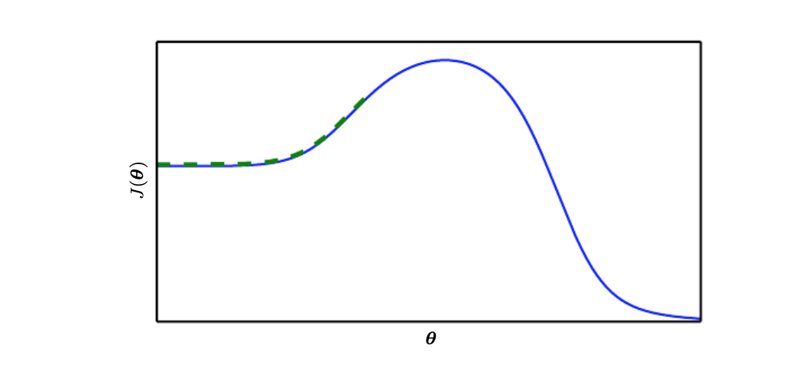
Local vs. Global Structure
If we initialize on the wrong point, we will end up at sub-optimal solution:

Slide 43
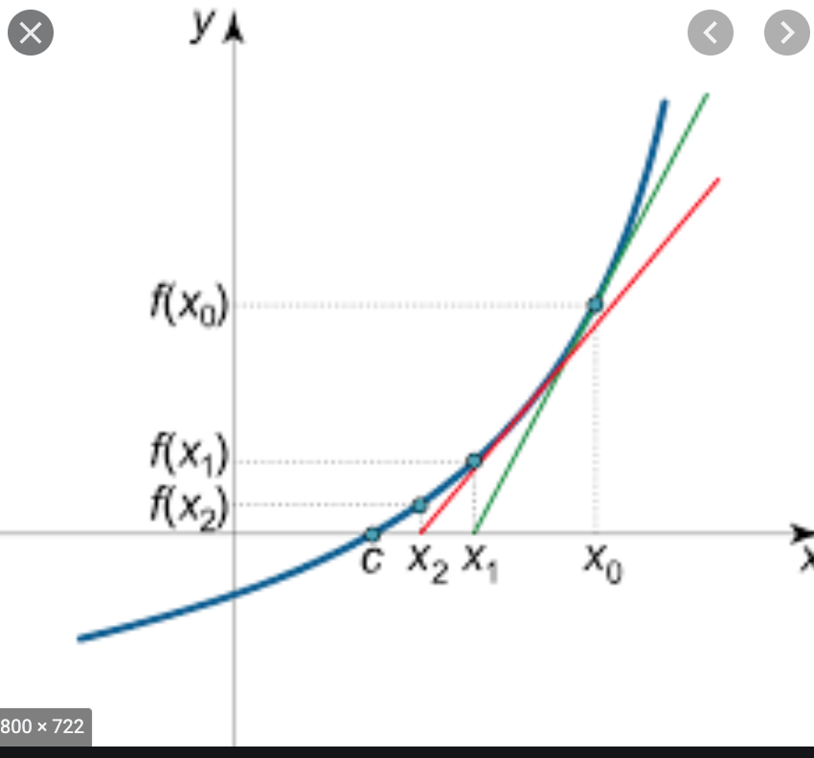

Second – Order Methods
Several mentioned in the book, most simple is newton’s method
Assume a quadratic function
Approximate the function as follows with Taylor Series:
If function truly follows this approximation, then solve directly for zero:

Slide 44
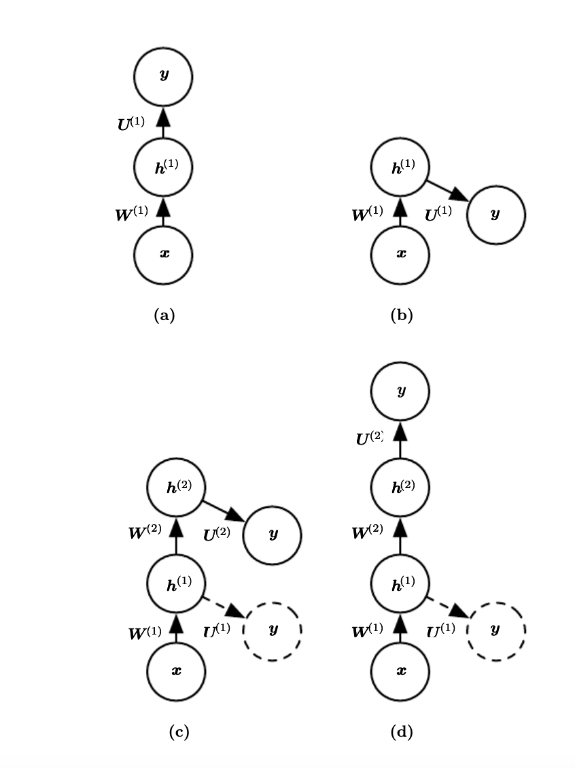
Supervised Pre-Training

Slide 45
Motivation
Model is too complex, break it down
Concept of a “greedy algorithm”
By pre-training, we provide guidance to the deeper layers on where to go
Basic idea:
Train a simple network with one layer
Remove hidden-output layer
Use the output of the hidden layer instead as an INPUT to another single layer network
Continue process and combine layers

Slide 46

Other Methods
Coordinate Descent:
Solves problem of solving an optimization problem quickly
Divide the input into several sets
Optimize one parameter at a time
Smaller problems easier/faster to solve
Polyak Averaging
Take a running average of the parameter values in all the different iterations
Intuition: image a valley. The optimization may bounce back and forth on the sides and not reach local minimum. The average will.
Use exponential average as well:

Slide 47
Appendix: Cross-Entropy vs Log- Likelihood

Slide 48
Motivation
Online resources//academic papers mention “binary cross-entropy” loss
Our book uses notion of “Maximum Likelihood Estimation”
MATLAB final layer (used in this network) computes the cross-entropy loss

Slide 49

Maximum Likelihood (negative log-likelihood cost function)
As defined in Eq. 5.61:
Essentially multiply the distribution of the data by the log of the distribution of the model parameters. Minimizing the negative of this means that the parameters lead to a prediction distribution that is highly similar to the data distribution that we see

Slide 50
Entropy & Information
Entropy is an attempt at quantifying the amount of “information” in a signal
i.e. sending a message via radio waves. How much content is in the radio wave, given that there will be a lot of noise?
Since there will be a lot of noise, events that are unlikely, i.e. signals that are very abnormal, carry a lot more information (sun rising tomorrow is not very informative, sun NOT rising tomorrow, quite informative)

Slide 51
Mathematics behind information
Information(x) = - log * P(x)
If we take the log of a normal Gaussian probability distribution it will mostly maintain its bell-likeshape. However, the values closer to 1 (high likelihood) are driven close to zero, and the values close to zero are driven to be very very low values.
Thus, when we take the negative log of a probability distribution, proabilites close to 1 are driven to be small and probabilities that are very low gain massive information!
This is the same sort of concept behind the log-likelihood in cost function, if our function predicts something with low-likelihood correctly, we should reward it much more strongly

Slide 52

Entropy
Once we have the information equation, Entropy is defined as follows:
Treat it as the expected amount of information in a probability distribution
i.e take your probability distribution and multiply it by the information found in it

Slide 53
KL Divergence
Now we can look at the mutual information between two separate probability distributions using concept of entropy
KL Divergence:
P and Q are probability distributions over the same variable. Instead of trying to find the entropy of just a single one of them, we subtract one probability from the other to get their difference. This gives us the “leftover” information of a distribution

Slide 54

Cross- Entropy
Finally we can define cross - entropy as some version of KL Divergence:
What changes is we not simply take the probability distribution of P and multiply it by the information found in Q, instead of taking the probability distribution of P and multiplying it by the difference in information between P + Q
This is exactly negative log-likelihood

Slide 55

In real-life applications
P is the “real” distribution (data) and q is the predicted distribution
Sum over training examples as proxy for true distribution:
This brings together why we see the above equation discussed as the cross-entropy; we are referring to the same thing

